Slide 1
Road to safer applications
Or how to best use all the capabilities offered by Symfony and its ecosystem to effectively protect our web applications

Slide 2
Application security is major concern.
Every application must be secure by design.

Slide 3
The Symfony Security component and bundle are key elements for managing user identification, authentication and authorization in a web application.
They provide a security infrastructure to protect routes and controllers using common concepts of users, roles, and rights.

Slide 4
Identification is the process of discovering a user's identity.

Slide 5
Authentication is the process of verifying a user's identity.

Slide 6
Identification and Authentication can be done
at the same time.

Slide 7
Symfony natively supports several identification and authentication methods including:
username/password combinations
X509 certificates
The magic links
Tokens (JWT, SAML2…),
…
And more via community bundles, external services.

Slide 8
Authorization is the process of verifying an authenticated user’s rights to perform an action.

Slide 9
For authorization/permission checking, Symfony uses “Voters”.
For example
a user with the "ROLE_ADMIN" role will have additional permissions than a user with the "ROLE_MODERATOR" role.
The owner of a resource or an administrator will have features denied to other users (e.g. deletion)

Slide 10
Objectives of this workshop:
Use different components to enhance a web application with multiple levels of security depending on functionalities.

Slide 11
Agenda
Morning
Welcome
Afternoon
To infinity and beyond
Meteofony
Symfony Security component
Security Best practices?
Password auth improvements
Sessions
Remember me cookies
Logging and monitoring
Client authentication
Access Tokens: custom, OAuth2 / OIDC
Webauthn
What about frontend?

Slide 12
Before we start
There are no stupid questions, only stupid answers.
Phil, Edinburgh, Scotland

Slide 13
Before we start
I am no security expert and we will not be after this workshop.
Florent, Brussels, Belgium

Slide 14

Mété
fony

Slide 15
Météofony is a web application based on Symfony that allows you to share your weather reports within a community.
It provides an API that allows client applications to retrieve statements.
Simple password protection has been implemented.

Slide 16
During this workshop, we will protect the application with the means offered by Symfony and its ecosystem.

Slide 17
Overview of Meteofony and setup
PHPStorm + Code With Me plugin
Link to the session:
Or Clone + Docker
git clone git@github.com:Spomky-Labs/meteofony.git
make build
make up
make watch
https://localhost

Slide 18
Symfony Security

Slide 19
Meet Symfony Security Component
User <=> Consumer of the application
User Provider
Authenticators
Passport
Badges
Events and Listeners
Firewall

Slide 20
Meet Symfony Security Component
=> User
The application consumer
Implements Symfony\Component\Security\Core\User\UserInterface

Slide 21
Meet Symfony Security Component
=> User Provider
Main task is to fetch user objects and keep them "fresh"
Implements Symfony\Component\Security\Core\User\UserProviderInterface

Slide 22
Meet Symfony Security Component
=> Authenticator
Main tasks are to generate a Passport depending on the request and issue the security token. Success and Failure events can be tweaked here,
Implements Symfony\Component\Security\Http\Authenticator\AuthenticatorInterface

Slide 23
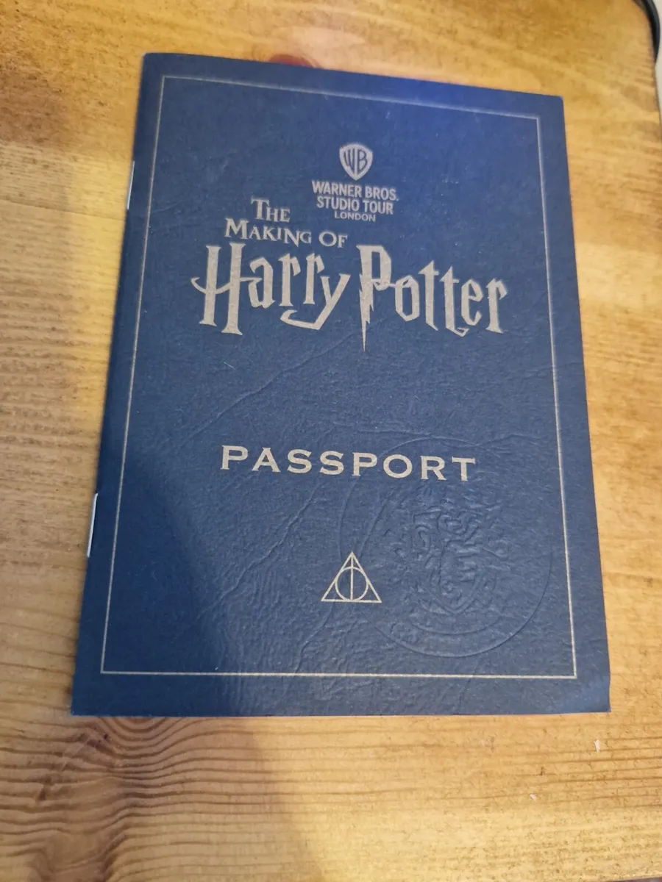
Meet Symfony Security Component
=> Passport, Badges, Events and Listeners
A Passport contains Badges that are resolved
By listeners.
All badges shall be resolved for the user to be authenticated

Slide 24
Meet Symfony Security Component
Example of Badges:
UserBadge: the user identifier corresponds to a user
PasswordCredentialBadge: the submitted password is correct
RememberMeBadge: enable the remember me feature
CsrfTokenBadge: checks the CSRF token is valid
You can add any badges you need.

Slide 25
Meet Symfony Security Component
=> Firewall
"defines which parts of your application are secured and how your users will be able to authenticate"
https://symfony.com/doc/current/security.html#the-firewall

Slide 26
Démystifions Security Bundle
Public area
Météofony
API
Member area
Administrator area

Slide 27
Security Best Practices

Slide 28
Best practices (and how to find them)
If you have to remember one, then it must be OWASP.
Open Worldwide Application Security Project®
https://owasp.org/

Slide 29
Guides
Secure Coding Practices-Quick Reference Guide
https://owasp.org/www-project-secure-coding-practices-quick-reference-guide/
Top ten
https://owasp.org/www-project-top-ten/
Cheat sheets (AJAX, clickjacking, JWT, password storage, PHP config…)
https://cheatsheetseries.owasp.org/

Slide 30
Other Resources
Depending on your country, government agencies may provide interesting guides
France: ANSSI (www.ssi.gouv.fr)
Germany: by the BSI (www.bsi.bund.de)
Austria: Federal Chancellery (www.digitales.oesterreich.gv.at)
Denmark: FCS – Center for Cyber Security (www.cfcs.dk)
Spain: OCSTI (www.oc.ccn.cni.es)
Estonia: RIA – Riigi Infosüsteemi Amet (www.ria.ee/en/)
Finland: FICORA (www.ficora.fi)
Italy: by OCSI (www.ocsi.isticom.it)
Luxembourg: National Agency for Information Systems Security Luxembourg (www.anssi.lu)
Norway: SERTIT (www.sertit.no)
The Netherlands: the NLNCSA (www.tuv-nederland.nl)
Poland: NASK (www.nask.pl)
The United Kingdom: NCSC– National Cyber Security Centre (www.ncsc.gov.uk)
Sweden: FMV/CSEC (www.csec.se)

Slide 31
Other Resources
Example:
RECOMMANDATIONS RELATIVES À L’AUTHENTIFICATION MULTIFACTEUR ET AUX MOTS DE PASSE
MULTI-FACTOR AUTHENTICATION AND PASSWORD RECOMMENDATIONS
https://www.ssi.gouv.fr/guide/recommandations-relatives-a-lauthentification-multifacteur-et-aux-mots-de-passe/

Slide 32
User identifier/Password improvement

Slide 33
User identifier / password
User authentication was implemented as follows:
symfony console make:auth
User entity with extra functions and IDs turned into strings
Basic UserRepository
Simple UserProvider
UsernamePasswordAuthenticator has as showed in the documentation

Slide 34
User identifier / password
Case-insensitive user identifier
Password entropy
Password storage (hashing functions)
Compromised passwords
Transmit passwords only over strong transport
https://cheatsheetseries.owasp.org/cheatsheets/Authentication_Cheat_Sheet.html
https://cheatsheetseries.owasp.org/cheatsheets/Password_Storage_Cheat_Sheet.html

Slide 35
Case-insensitive user identifier
John.Doe ⬄ jOHn.Doe ⬄ john.doe ⬄… should refer to the same user

Slide 36
No suspicious characters
рrinсeѕѕ.ﬁonа👸🏼

Slide 37
No suspicious characters
рrinсeѕѕ.ﬁonа👸🏼
https://freetools.textmagic.com/unicode-detector

Slide 38
No suspicious characters
"р" - This is a Cyrillic letter "pe" (pronounced as "p"), used in languages like Russian.
"с" - This is another Cyrillic letter, "se" (pronounced as "s"), used in languages like Russian.
"ѕ" - This is another Cyrillic letter, "dze" (pronounced as "s" or "dz"), used in languages like Serbian and Macedonian.
"ﬁ" - This is a Latin letter "fi" ligature. Ligatures are typographic elements that combine two or more letters into a single character for aesthetic or readability reasons.
"а" - This is a Cyrillic letter "a," used in languages like Russian.

Slide 39
Coding time!
Make sure the searched username is case insensitive
Make sure only ascii characters are allowed for a user identifier
Hint: https://github.com/symfony/symfony/pull/51744

Slide 40
Password entropy
Entropy?

Slide 41
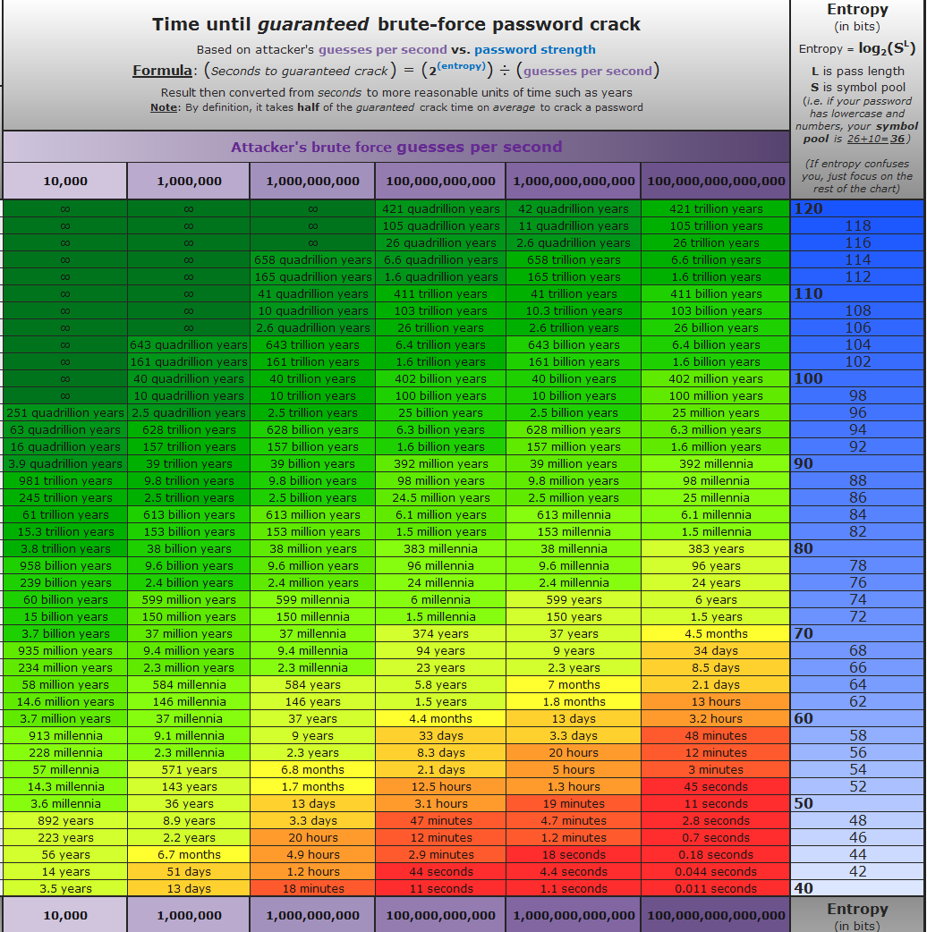
Password entropy

Slide 42
Password entropy

Slide 43
Password entropy

Slide 44
Password entropy
Entropy ⇔ unpredictability (and therefore impossible to guess).
Good entropy = sufficient length and pool of characters

Slide 45
Coding time!
When the user changes the password:
Make sure the password length is at least 12 chars long
Make sure the password strength is high
Hint: https://symfony.com/doc/current/reference/constraints.html

Slide 46
Password storage
How do we store passwords in the DB?

Slide 47
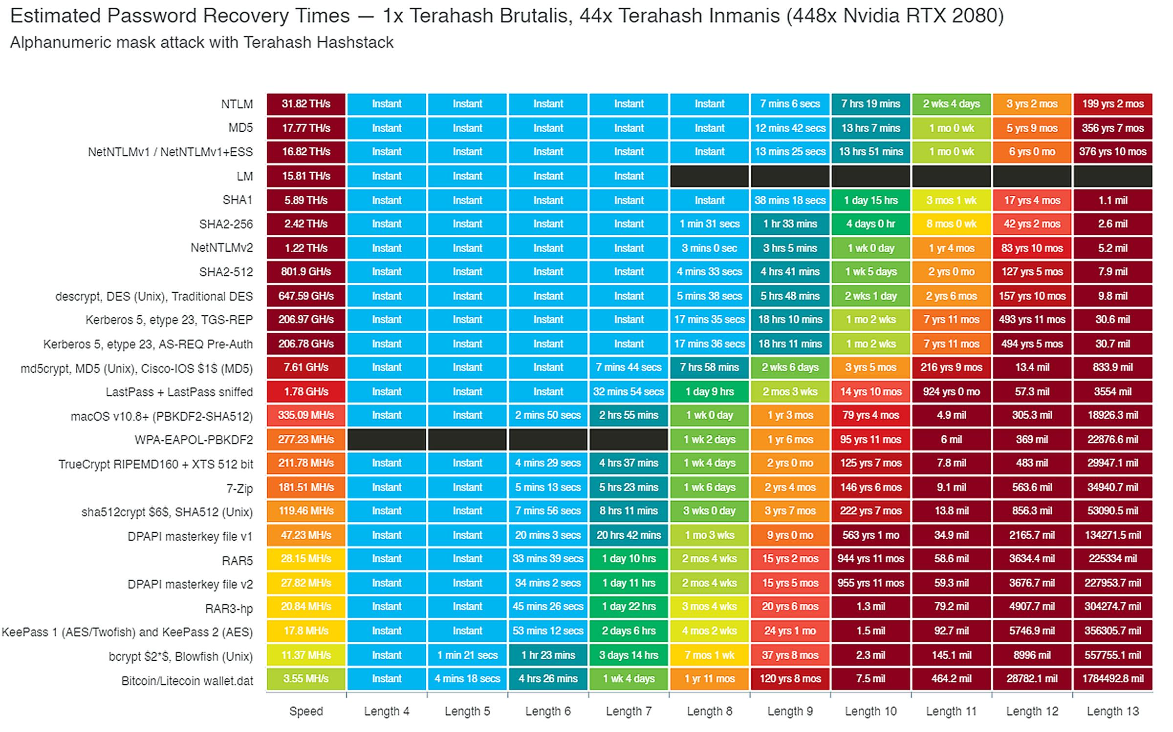
Password storage

Slide 48
Password storage

Slide 49
Password storage

Slide 50
Password storage
Hashing function itself is not sufficient. Salt is mandatory.
All hashing functions are not suitable for password storage. It should:
Protect from rainbow tables
Be bruteforce resistant
Be costly in term of memory, time and GPU/CPU

Slide 51
Benchmark
php vendor/bin/phpbench run tests/Benchmark --report=simple

Slide 52
Coding time!
Make sure the hashing function for password storage is safe

Slide 53
Compromised passwords?
https://haveibeenpwned.com/
More than 12B pwned accounts

Slide 54
Coding time!
Make sure the user cannot change its password with a compromised one
Hint: https://symfony.com/doc/current/reference/constraints.html

Slide 55
Coding time!
Advanced behavior: make sure the user cannot log in if the password is compromised

Slide 56
Throttling
Symfony 5.2+
Denies a user from attempting logins after a certain number of failed attempts
https://symfony.com/blog/new-in-symfony-5-2-login-throttling

Slide 57
Coding time!
Implement the Login Throttling feature.
3 failed attemps within the last 5 minutes should block the user
Do the same for password reset page.

Slide 58
Multi factor authentication
What are the factors?

Slide 59
Multi factor authentication
Three factors:
Something you know: PIN code, password, secret phrase...
Something you have: smartphone, security device...
Something you are: fingerprint, palm, face...
Multi factor authentication is the combination of at least 2 factors.
Having 1 PIN code and a password is still 1 factor authentication!

Slide 60
Coding time!
Implement MFA (email-based)
https://symfony.com/bundles/SchebTwoFactorBundle/6.x/index.html

Slide 61
User identifier/Password – Key points
Case-insensitive user identifier
Passwords should have:
High level of entropy
Adequat hashing function for storage
Compromised passwords should be detected and avoided
HTTPS should be used when transmitting credentials
Enable throttling on login and password reset
MFA should be possible for all users, in particular those with elevated rights

Slide 62
Sessions

Slide 63
Sessions
By default, the sessions is managed by the "native" storage i.e. PHP's built in file storage
Missing feature:
Allow the user to see all active sessions
Detect anomalies
Manually invalidate other sessions
Prevent simultaneous logins
https://cheatsheetseries.owasp.org/cheatsheets/Session_Management_Cheat_Sheet.html

Slide 64
Coding time!
Store and manage sessions in the DB
Hint: https://github.com/symfony/symfony/pull/52412

Slide 65
Remember me cookies

Slide 66
Remember me cookies
Remember me cookies are critical piece of data and shall be protected
Make sure protection options are at the best level
Samesite: strict
Httponly: true
Secure: true
Lifetime: depends on the context (7 days, 15 days, 1 month…)
Use path if needed

Slide 67
Remember me cookies
If you can manually invalidate sessions, a malicious user can be logged in thanks to a rememberme cookie
The rememberme cookie contains a token used to retrieve the user and refresh it
You can manage session tokens in the DB

Slide 68
Coding time!
Tweak the remember me cookie security options
Store and manage remember me tokens in the DB
Hint: https://symfony.com/doc/current/security/remember_me.html

Slide 69
Logging and monitoring

Slide 70
Logging and monitoring
Security events:
Login success/failure
Logout
Password changed
MFA success/failure
GeoIP…

Slide 71
Coding time!
Store some security events in the DB

Slide 72
Session, Cookies, Logging and Monitoring – Key points
Logging every security events will allow fraud detection
Allow the user to see active sessions and remember me cookies
Allow users and admin to revoke sessions them if needed

Slide 73
Captcha

Slide 74
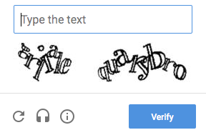
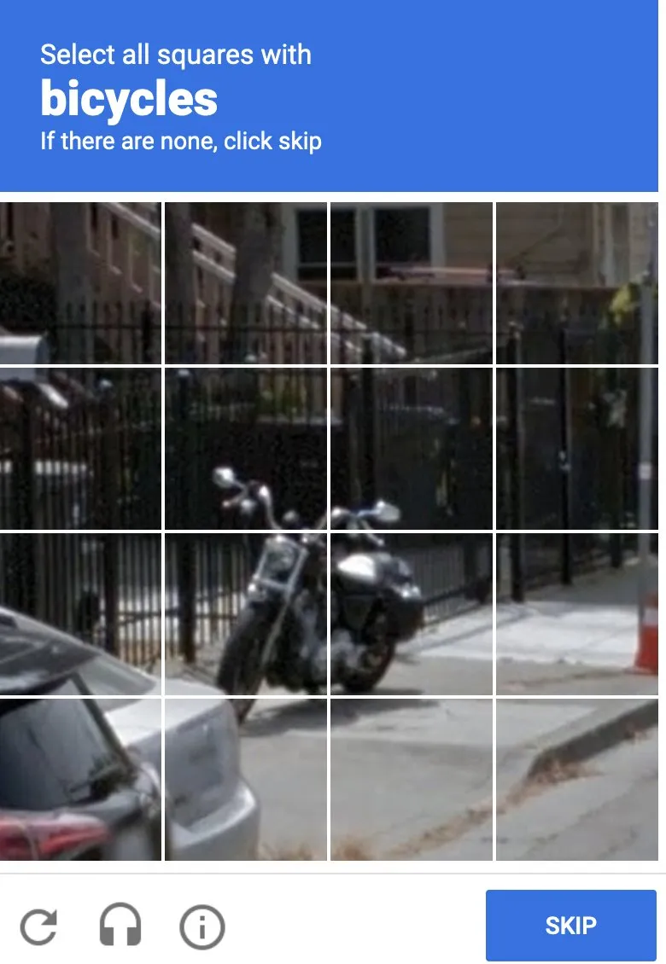
Captcha 🤔

Slide 75
Captcha 😥
🈲You should avoid them️⛔
Captchas are not reliable
Most solutions are not GDPR compliant (General Data Protection Regulation)
Captchas are boring/frustrating for all users, in particular for users with disabilities or visual impairments
(not so) Sophisticated bots or AI can kill them all in a second.

Slide 76
Captcha => Private Access Token 😁
New authentication schema: PrivateToken
PrivateToken challenge=blah-blah-blah, token-key=xxxxxxxxx
Live demo: https://patdemo-o.edgecompute.app/
If the broswer is not compatible, you should continue with Captcha.

Slide 77
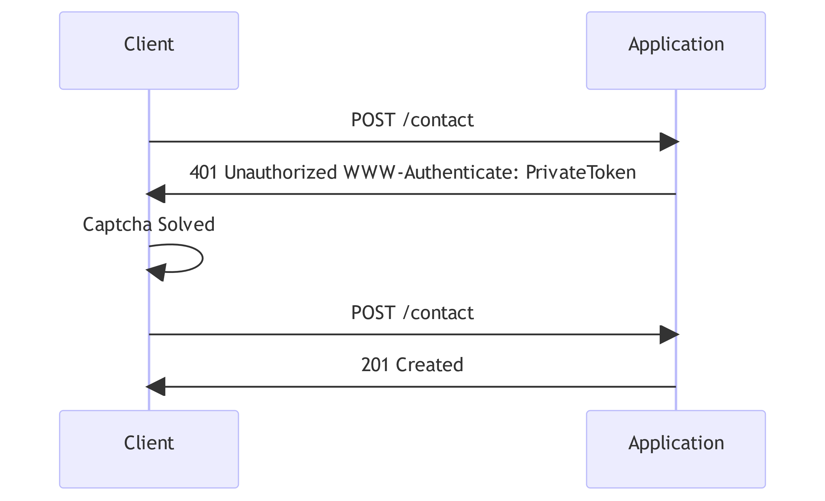
Captcha => Private Access Token 😁
With Captcha

Slide 78
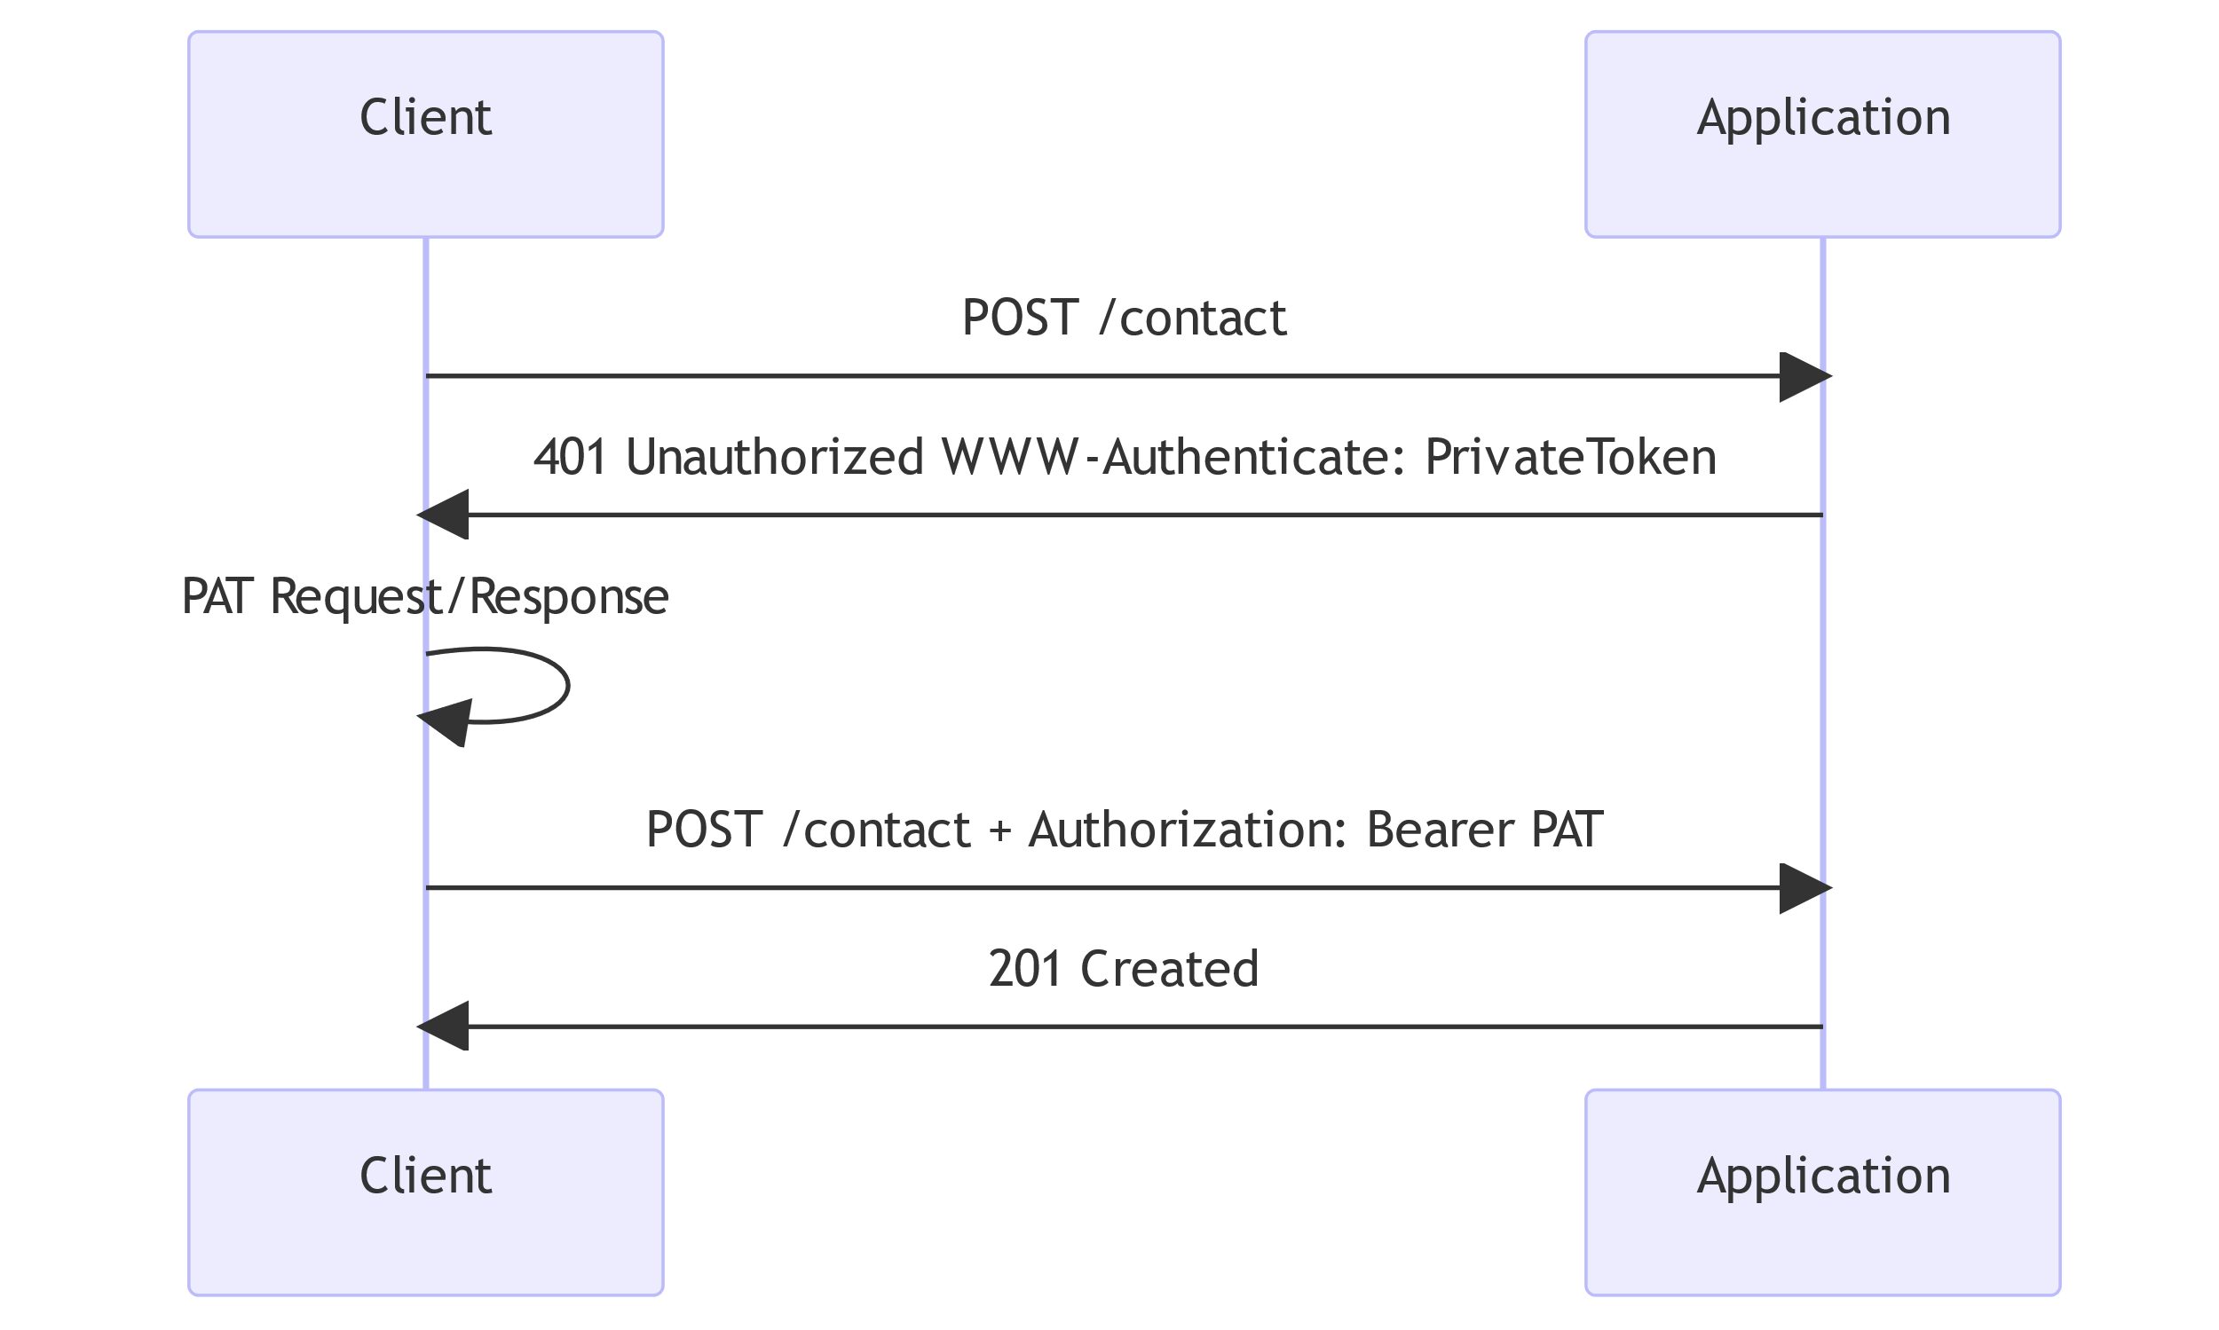
Captcha => Private Access Token 😁
With PAT

Slide 79
Captcha => Private Access Token 😁
IETF drafts: https://datatracker.ietf.org/doc/draft-private-access-tokens/
Other resources:
Fastly: https://www.fastly.com/blog/private-access-tokens-stepping-into-the-privacy-respecting-captcha-less
Cloudflare: https://blog.cloudflare.com/how-to-enable-private-access-tokens-in-ios-16-and-stop-seeing-captchas/
Apple: https://developer.apple.com/videos/play/wwdc2022/10077/

Slide 80
Captcha => Private Access Token 😁
What about Symfony applications?
Not implemented yet, but work is in progress
See https://github.com/symfony/symfony/issues/51521

Slide 81
Client Authentication

Slide 82
Client Authentication
We can use the user session on the client device for authentication
Dedicated for large companies or when high security level requirements is required
A PKI is needed

Slide 83
What is a PKI
PKI = "Public Key Infrastructure"
A PKI aims to manage the cryptographic keys used in an entity (government, company or other).

Slide 84
What is a PKI
Cryptographic keys have different uses:
Issue certificates,
Securing communications between servers or between clients and servers,
Authenticate hardware or users
Sign or encrypt documents (storage, contract, etc.),
Sign revocation lists
…

Slide 85
Overview of a PKI
Organization
Agency #1
…
Devices
Server #1
Server #2
Agency #2
Users
John Doe
Jane Doe
Robert Doe

Slide 86
You encounter PKIs every day
…without even knowing it.
There is a certificate behind each HTTPS request, including during the development cycle of your applications:
symfony server:ca:install # Create a local Certificate Authority for serving HTTPS
symfony serve

Slide 87
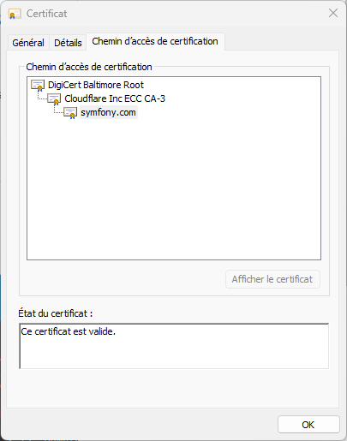
Example symfony.com web server

Slide 88
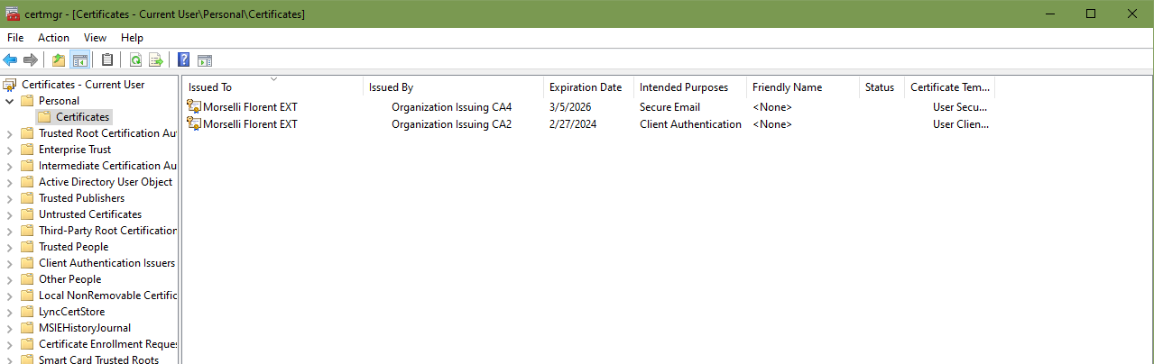
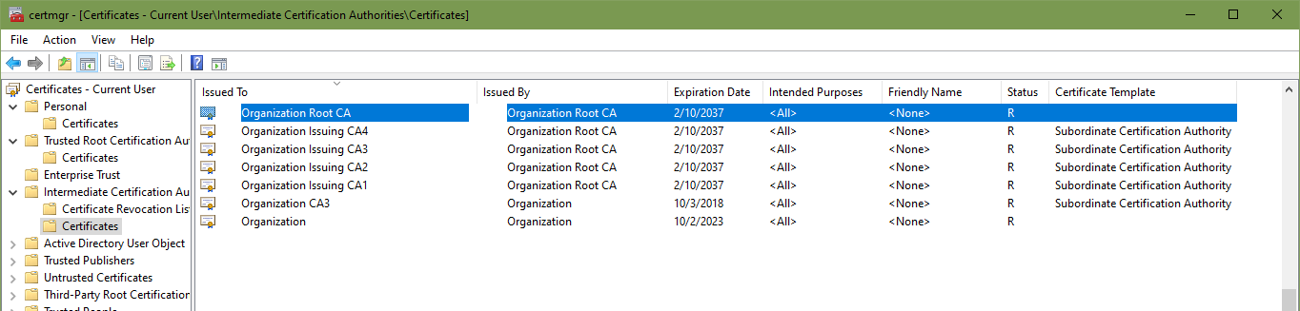
Concrete example from “certmgr.msc”(Windows)

Slide 89
PKI pros & cons
Ease of use
High level of trust and security
Control of validities and revocations
Technology proven for many years
Support in many applications and systems
Requires organizational processes
Requires protections (hardware) against the extraction of private keys
Authoritative certificates are critical, especially the root certificate
High cost, not suitable for small entities

Slide 90
Public and Private key usages
Private keys are used to:
Sign the data i.e. create a digital signature
Decrypt the data i.e. restore plaintext
Public keys are used to:
Verify the data i.e. confirm the data has not been tampered
Encrypt the data i.e transform into a cyphertext

Slide 91
Public and Private key usages
Private keys should never be shared except through secure means of communication and only to authorized parties.
Public keys can be shared with anyone or any service

Slide 92
Implementation in our application
To achieve this:
Creation of our in-house PKI and our root certificate
Server side:
Intermediate certification authority for our user accounts
Server Setup
Configuring the Symfony app
Client side:
User certificate issued by our certification authority

Slide 93
Our PKI thanks to xCA
Simplify the task (and cost) of creating certificates with xCA
https://hohnstaedt.de/xca/index.php

Slide 94
Server Setup
Apache, Nginx, Caddy?
https://symfony.com/doc/current/security.html#x-509-client-certificates

Slide 95
Access Tokens

Slide 96
Access Tokens
For API protection
Access Token Handler
OAuth2 and OIDC

Slide 97
Access Tokens
Two token types:
By reference: an identifier for stored data on a service (e.g. DB)
By value (self-contained): data structure that contains metadata and claims. Protected (digitally signed or encrypted) and time-limited
SAML, JWT, Paseto...

Slide 98
Coding time!
Protect the API endpoints with access tokens
1 AT/user. The access token is stored in the DB

Slide 99
Webauthn
No password, no problems!

Slide 100
Webauthn
Uses « Authenticators » for managing credentials.
User interaction is required
User may be verified by additional means e.g. PIN; fingerprint, facial recognation…
Each credential is a private/public key pair, unique for a relying party and private key cannot be shared

Slide 101
Webauthn
Most of the time, no need for a form during the login; just a simple button to push

Slide 102
Webauthn
Install:
web-auth/webauthn-symfony-bundle: Symfony bundle
web-auth/webauthn-stimulus: ease frontend integration
Accept the recipe

Slide 103
Webauthn
Setup:
Env vars
The Webauthn Credential Entity
The Webauthn Credential and Webauthn User repositories
Do not forget to migrate your DB (d:m:diff and d:m:m)
Recompile frontend if needed

Slide 104
Webauthn
Config:
Enable a controller to allow the user adding authenticators
Enable the firewall and set custom routes for login
Add a form on the login page
Add a form on the profile page
List authenticators on the profile page

Slide 105
What else?

Slide 106
Frontend
Protection for cookies,
CSP,
Sniffing, HSTS, XSS…
Clear-Site-Data…
CORS

Slide 107
Frontend
Clear-Site-Data
Hint: https://symfony.com/doc/current/reference/configuration/security.html

Slide 108
Frontend
CORS => Cross-Origin Resource Sharing
Origin may be different when the client has not the same URL as the serveur (e.g. Client URL = https://foo.bar and Server URL = https://192.168.100.12:8000)
nelmio/cors-bundle

Slide 109
Frontend
Protection for cookies, CSP (Content-Security-Policy), Disable Content Type Sniffing, HSTS, XSS…
nelmio/security-bundle

Slide 110
W3Techs
https://w3techs.com/
W3Techs provides information about the usage of various types of technologies on the web.

Slide 111
Can I use?
https://caniuse.com/
https://caniuse.com/?search=webauthn
https://caniuse.com/?search=csp
https://caniuse.com/?search=importmap
…

Slide 112
Contribute to Symfony Security
https://github.com/symfony/symfony/issues?q=is%3Aopen+is%3Aissue+label%3ASecurity

